Slide 1


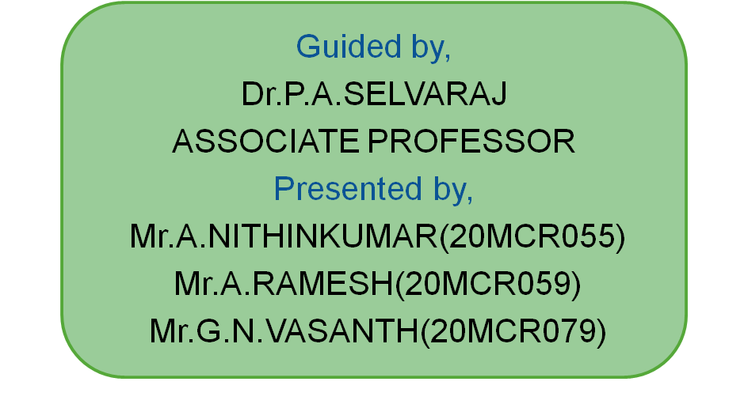

ONLINE TEXTILE MANAGEMENT

Slide 2
ABSTRACT
The objective is to develop an website for textile shop.
In early system the customer has to directly visit the shop for buying and it take more time.
This system allows customer to order the products from anywhere in less time consumption.
It is also an cost effective compared to the exiting system.
Allows to search the particular clothes needed for the customer and home delivery is available.

Slide 3
EXISTING SYSTEM
Customer need to buy clothes directly from the shop.
Home delivery is not available.
Customer records are maintained manually.
No sales in lockdown because of Covid-19.
High in cost

Slide 4
PROPOSED SYSTEM
Lower cost when buying through website.
Can accessible at any place and time.
High availability of every types of clothes.
Every user has a separate account in the website.
Can purchase also during Pandemic situation.

Slide 5
HARDWARE AND SOFTWARE REQUIREMENTS
Software Requirements:
WampServer
Notepad++
Hardware Components:
Processor – i3
Hard Disk – 2 GB (minimum)
Memory – 1GB RAM (minimum)

Slide 6
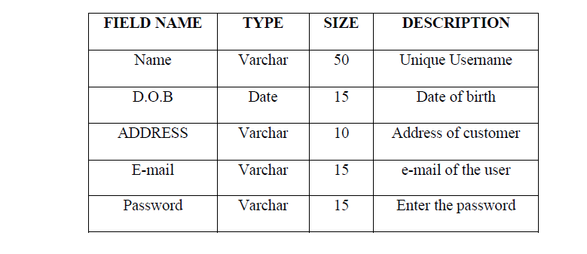
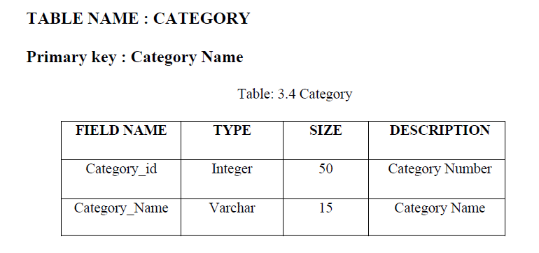
TABLE DESIGNS
Customer Table
Category Table

Slide 7
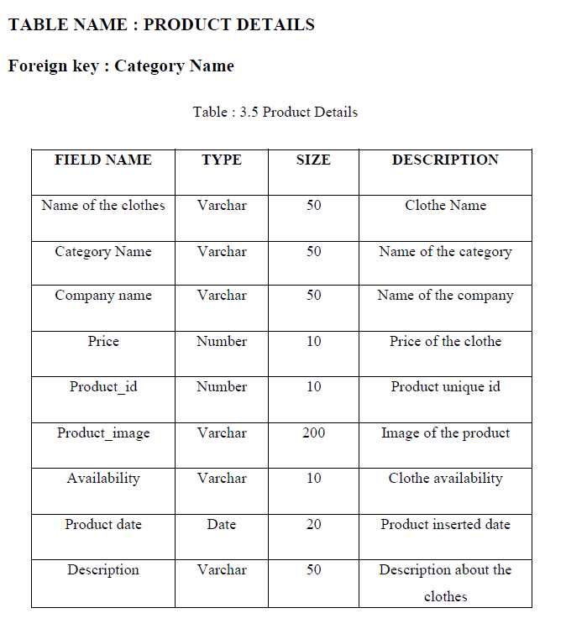
Product Table

Slide 8
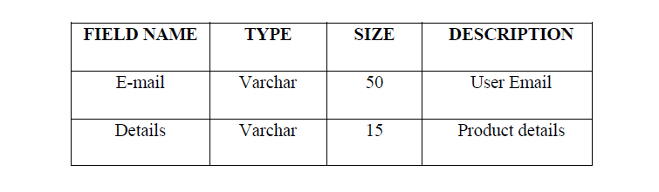
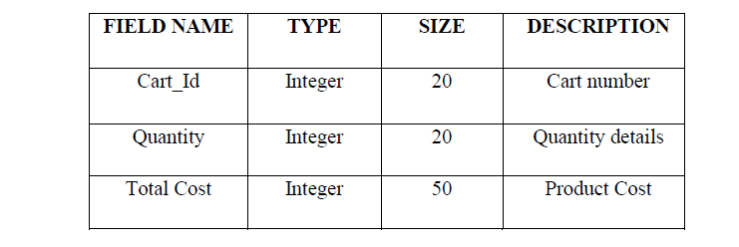
Feedback Table
Cart Table

Slide 9
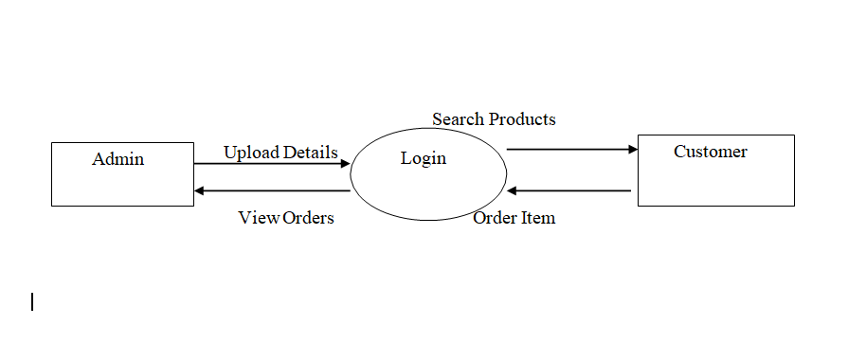
DATA FLOW DIAGRAM LEVEL 0

Slide 10
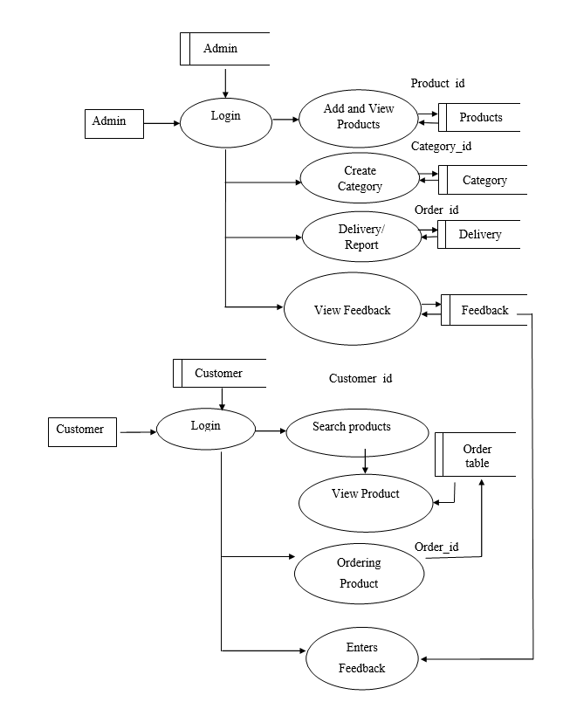
DATA FLOW DIAGRAM LEVEL 1

Slide 11
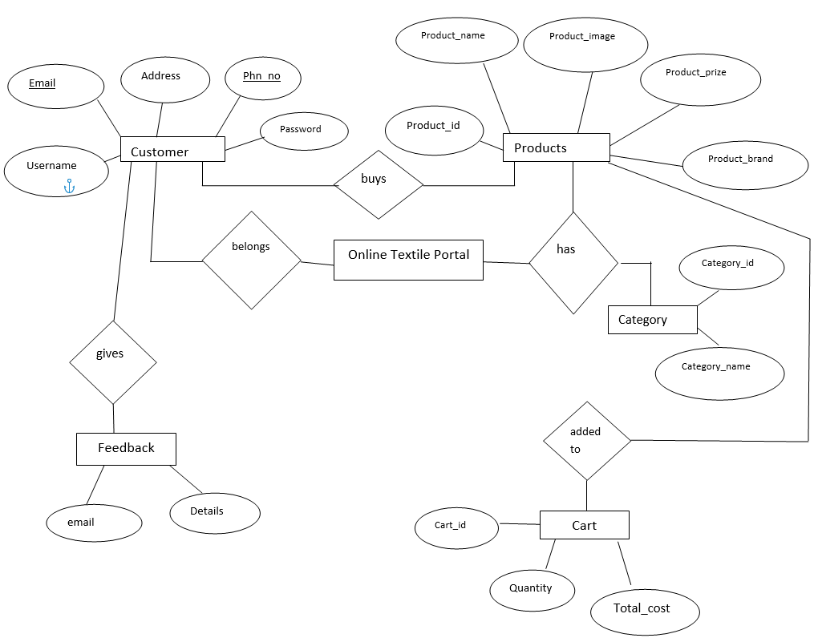
ER DIAGRAM

Slide 12
MODULES
Login/ Registration Module
Admin Module
Ordering Module
Delivery Module
Feedback Module

Slide 13
ADMIN MODULE
In admin module the admin will insert all the product which is in availability.
Based upon the products the category will be created by the admin.
Admin can manage the product like upload, delete, update of the products.
Ordered products will be seen by admin and delivered to customers.

Slide 14
ORDERING MODULE
In this module the admin will post all kind of clothes available in the stock.
Then the customer should register and login to the website.
After login the customer can search the product and can place the order.

Slide 15
DELIVERY MODULE
In delivery module the customer can order the product and choose the payment method like cash on delivery and Google pay method.
After placing the order the admin can view the order of the customer and deliver the products.

Slide 16
FEEDBACK MODULE
In feedback module the customer can give the feedback about the product.
The given feedback can be viewed by the admin for further development in future.

Slide 17
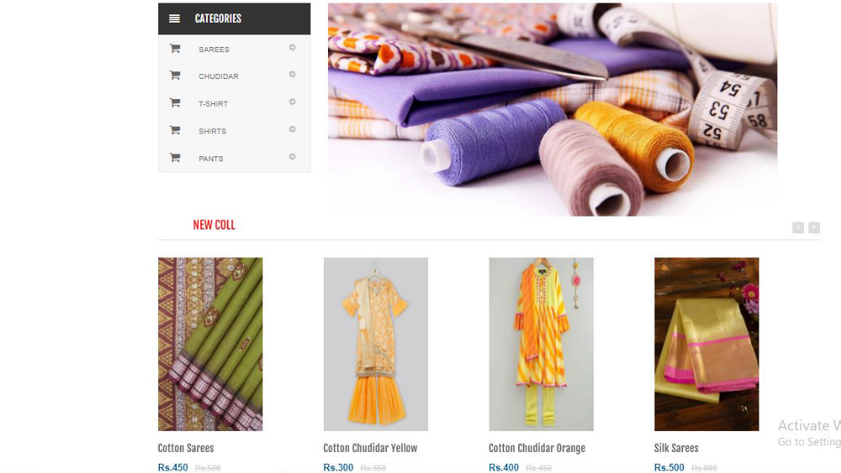
SCREENSHOTS
Login Page
Home Page

Slide 18
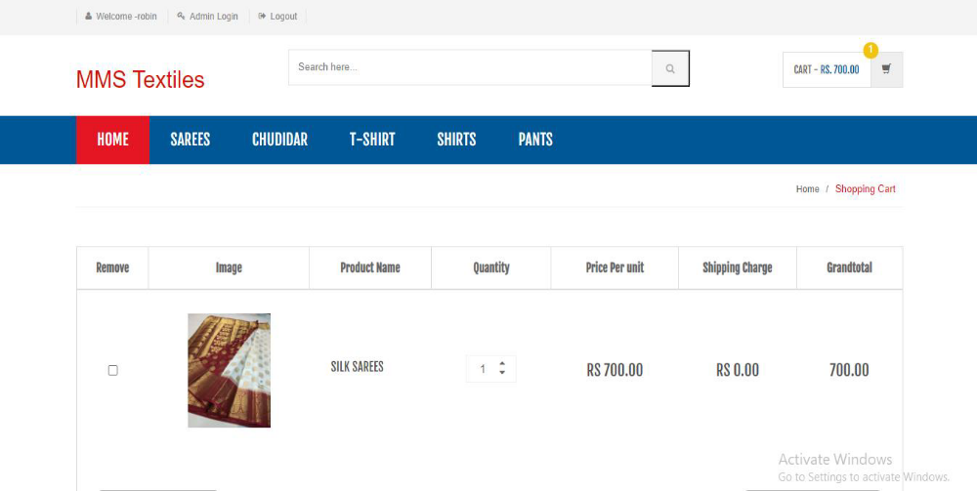
Shopping Cart

Slide 19
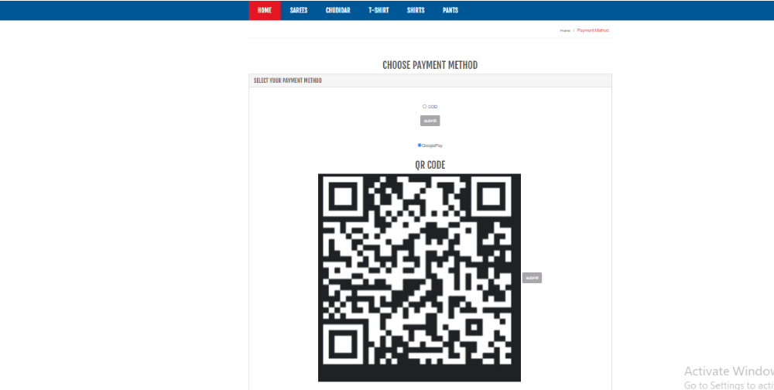
Payment Method

Slide 20
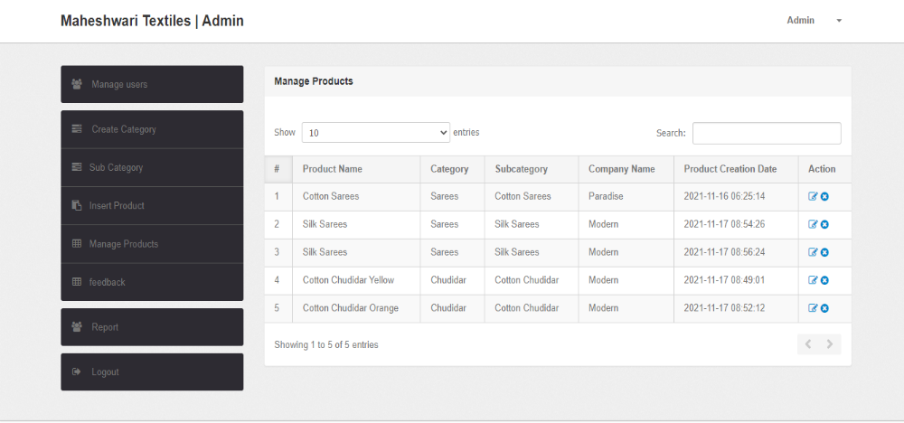
Manage Products

Slide 21
CONCLUSION
From this project it is concluded that, this website helps in efficient management of day to day activities involved in firm.
It also helps customer to easily search and order products through online.
The application is designed such that minimum internet knowledge is required for end users to browse the web site.

Slide 22
FUTURE ENHANCEMENT
    Application is designed as web service, it can be integrated with many web sites.
    If notification is sent as SMS, it becomes more helpful.
Android Application can be developed to be more effective for the customers.

Slide 23
REFERENCES
    Jason Glimore, “Beginning PHP and MySQL”, FourthEdition,Zend Framework Publications, 2010.
    David Skalr, “Learning PHP 5”, First Edition, Tata McGraw Hill, 2011.
    Brett McLaughlin, “PHP & MySQL: The Missing Manual”, Vikas publishing house pvt., Ltd., First Edition, 2000.
    https://www.w3schools.com/ W3 Schools Online Tutorials.
    https://www.tutorialspoint.com/execute_php_online.php Tutorials point Online.

Slide 24
THANK YOU

